Slide 1


When will Back to School be Cool?
Name we love school Team: Lemon Lin Reimer, Ranqing (Ellen) Lan, Bolim (Sydney) Son, Changwei (Wendy) Wang and Elliott Tran
Click Me!!

Slide 2
Case study
USA

Slide 3
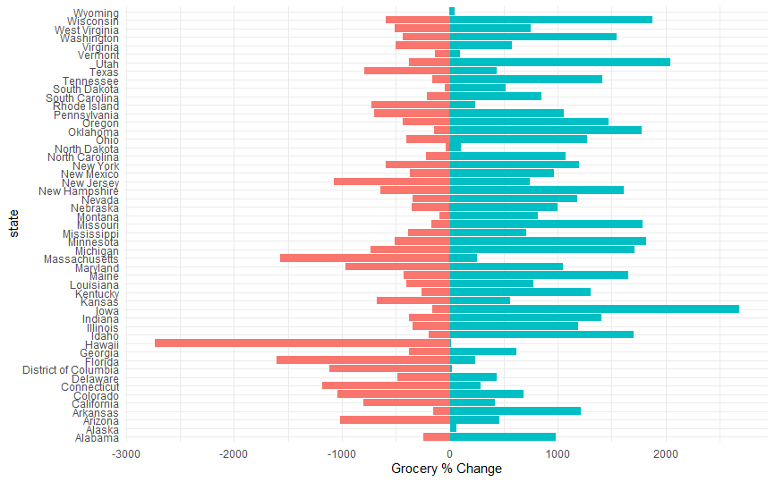
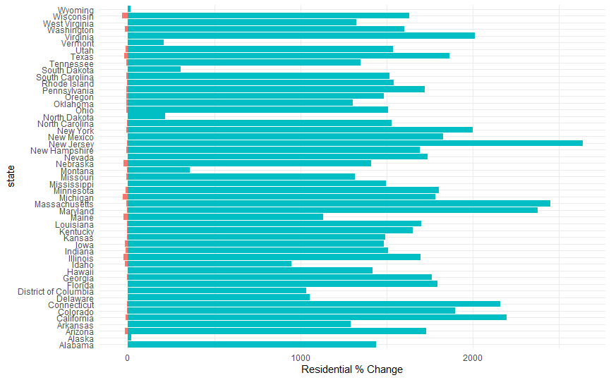
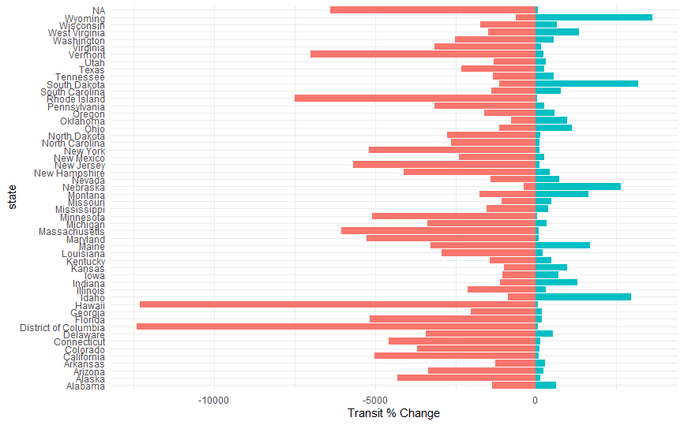
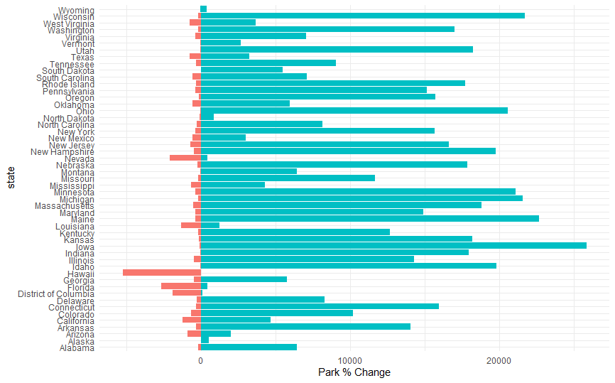
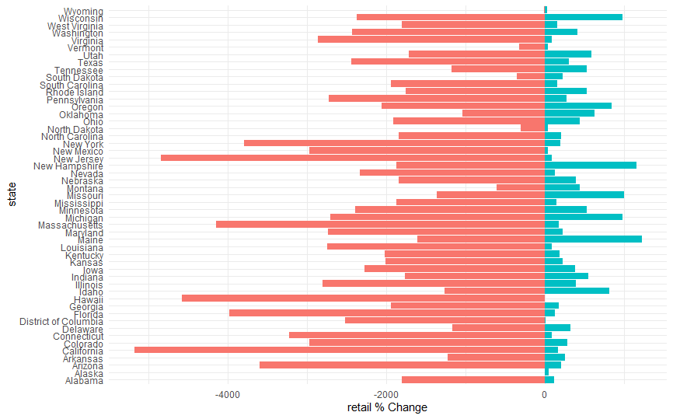
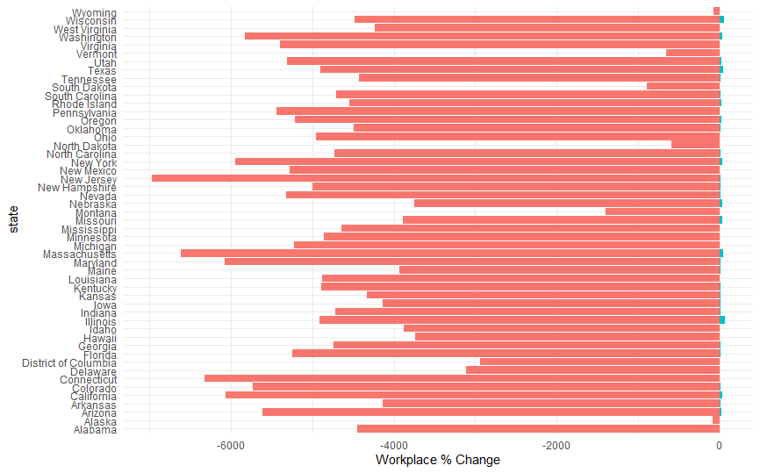
Mobility Patterns
Notes:
x : Mobility % variables, y = states; average over time

Slide 4
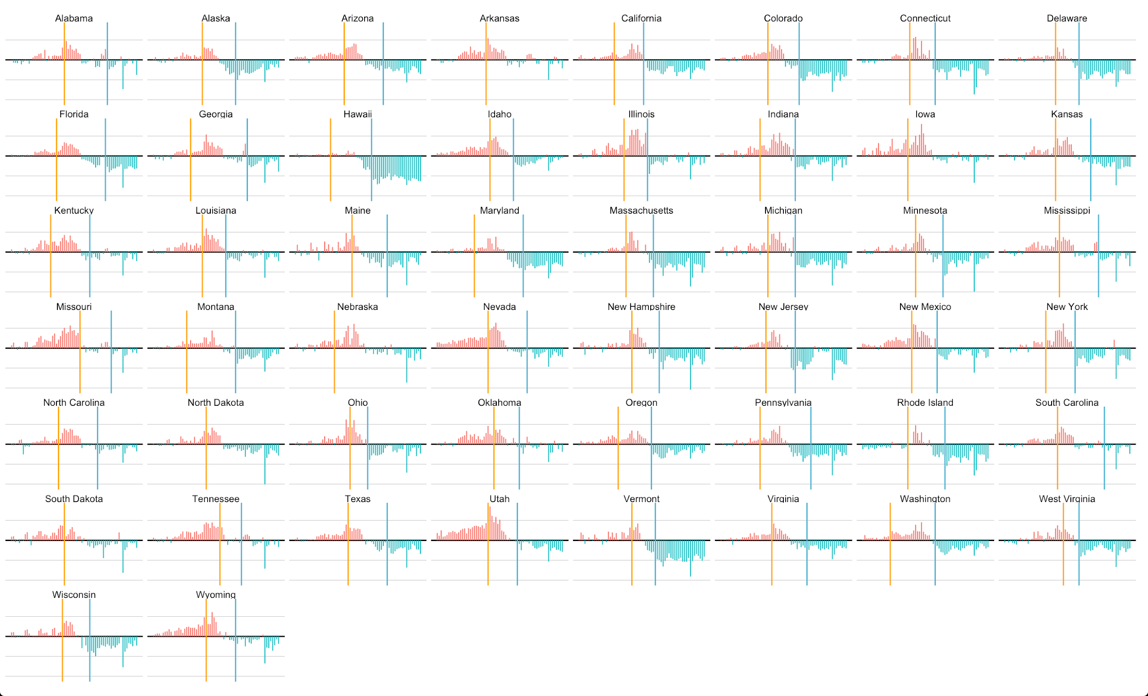


Date Declared Emergency
Panic Shopping
Date Stay-at-Home Took Effect
Notes:
The y-axis means the grocery_and_pharmacy_percent_change_from_baseline:
the red part means the change is above 0, meaning people increased their grocery and pharmacy purchase tour,
The green part means the change is below 0, meaning this mobility decreased.
Overall, around the **yellow vertical line** (when the each gov declared health emergency or state of emergency), the grocery store tour increased a lot. The the drop happened around the stay-at-home order.
The x-axis is between Feb to May.

Slide 5
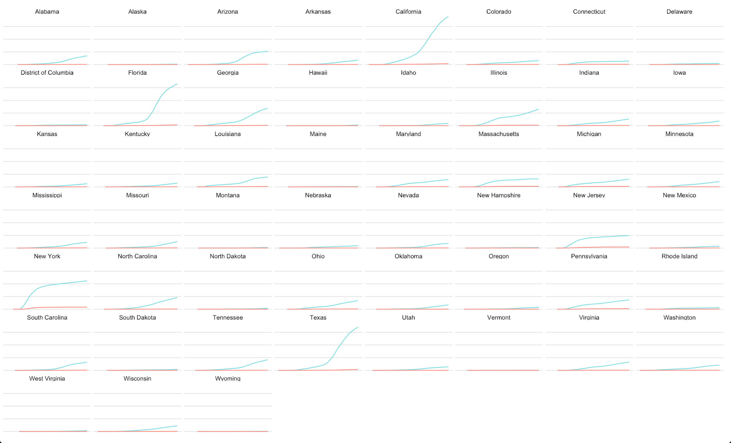
Confirmed Cases and Death

Slide 6

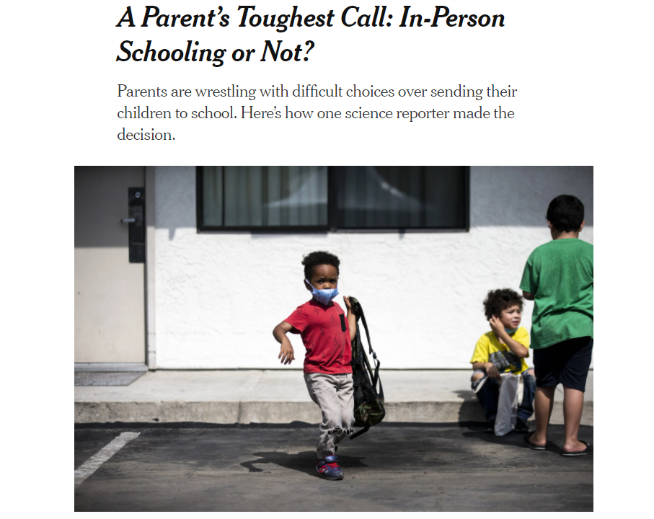
Notes:
In-person or remote schooling has become a hot topic of debate in the U.S. recently. Given the current state of the U.S.’ confirmed cases and deaths, it is expected by education officials that schools will remain closed until further notice.

Slide 7
What about the rest of the world?

Slide 8
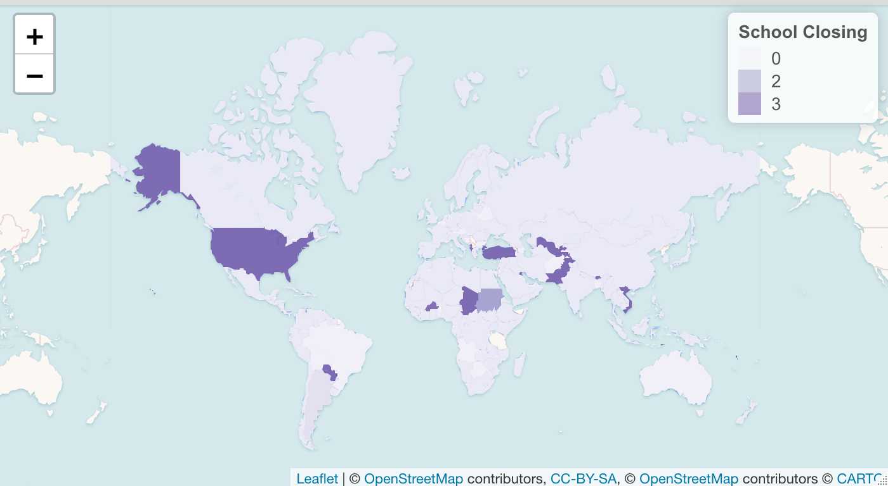
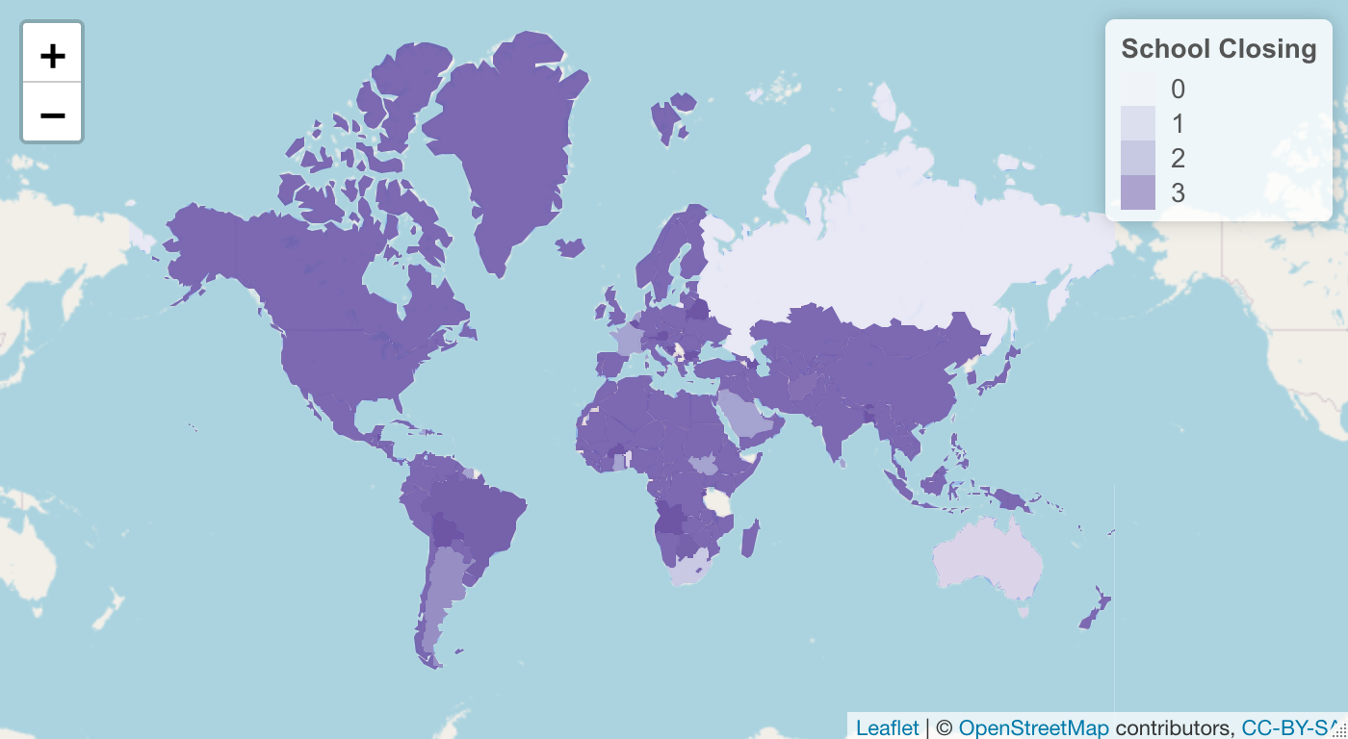
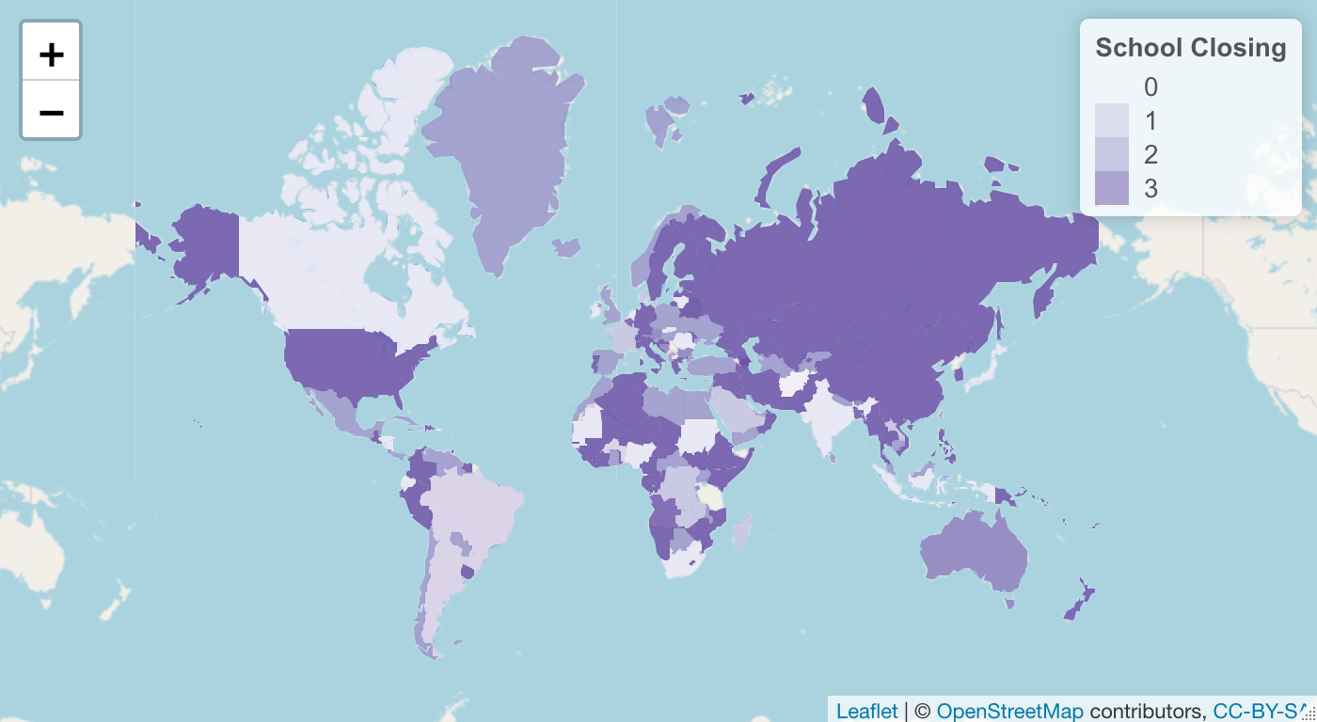
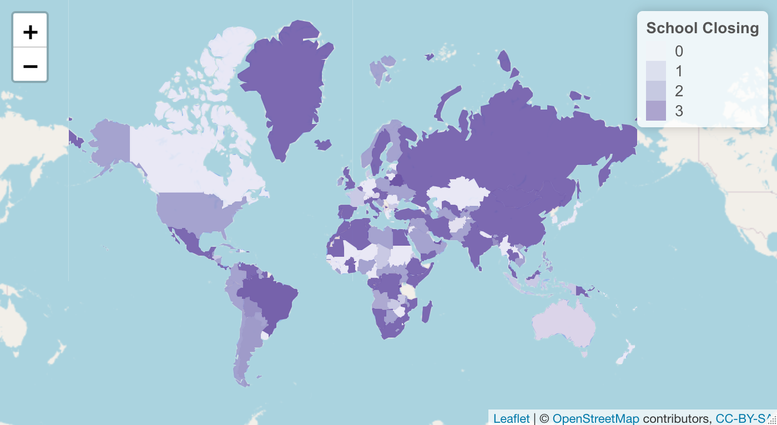
Mar
May
Jul
Sept
Notes:
The School_closing variable indicts how school are strictly limited by the local government to open, 0 means no limitation imposed on reopening, whereas 3 means requires remain closed at all level. As the maps suggests, schools are gradually closed down from march to may (more purple areas), and some countries started to reopen their schools (less purple).

Slide 9
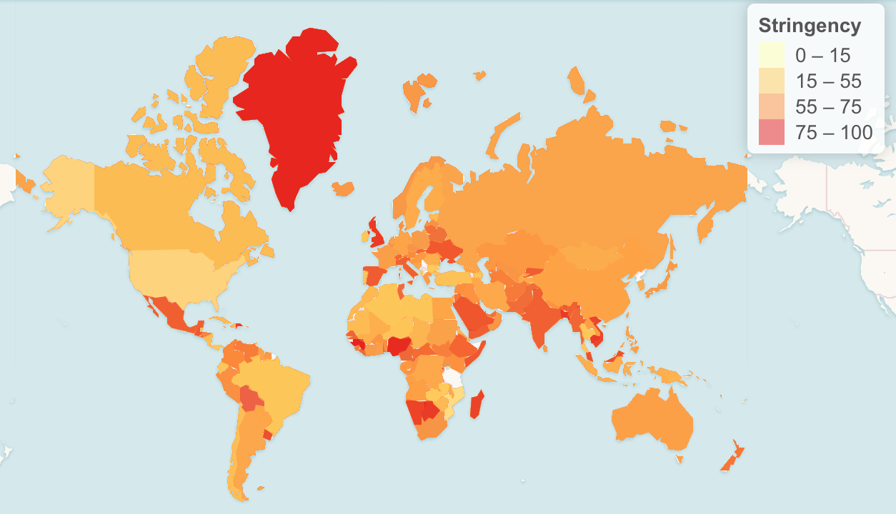
Covid-19 Policy Stringency Index
Notes:
It reports a number between 0 to 100 that reflects the overall stringency of the governments response
Oxford government re(aggregated) average? Yes

Slide 10
Research Question
Can factors like mobility and government action predict when schools will reopen for a country?

Slide 11
Datasets & Variables:
1.
3.
2.
Mobility Impact
Oxford Government Response Tracker
Retail and recreation
Grocery and pharmacy
Parks
Transit station
Workplace
Residential
School closing
Stringency index
Testing policy
Contact tracing
Emergency healthcare investment
Vaccine investment
Covid-19 Open Data
Deaths
Confirmed cases
Notes:
Click on headers for links

Slide 12
Time-to-event Analysis

Slide 13
Data Modeling
1.
2.
Input
Output
Testing policy
New COVID confirm cases
Stringency
Average spending on healthcare (USD)
Average spending on vaccines (USD)
School reopening
Days to reopen

Slide 14
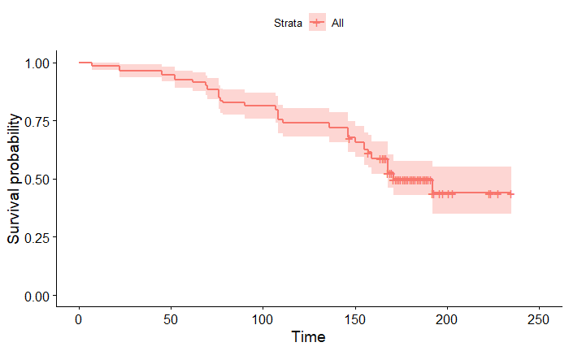
How long will it take for schools to open?
Notes:
NOTE: time is in days, survival probability is counter-intuitive because it’s the probability of school remaining closed. A lower survival probability is a good thing because it means a higher likelihood of schools reopening!

Slide 15
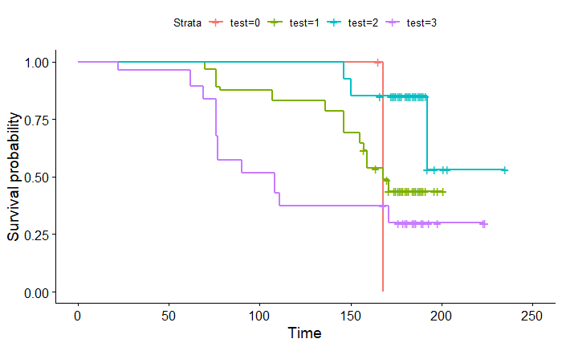
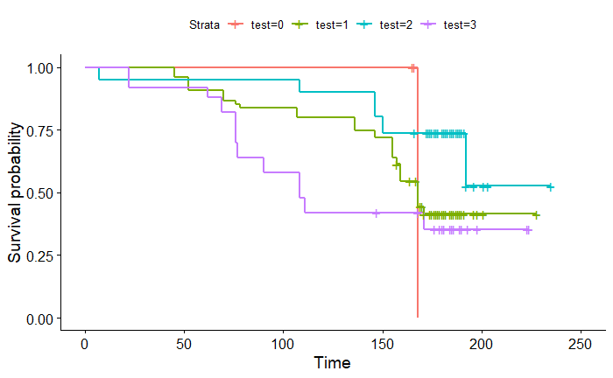
School reopening in respect to testing policy?
Notes:
NOTE: test refers to the testing_policy variable, where 0 = no testing for covid and 3 = lots of testing for covid

Slide 16
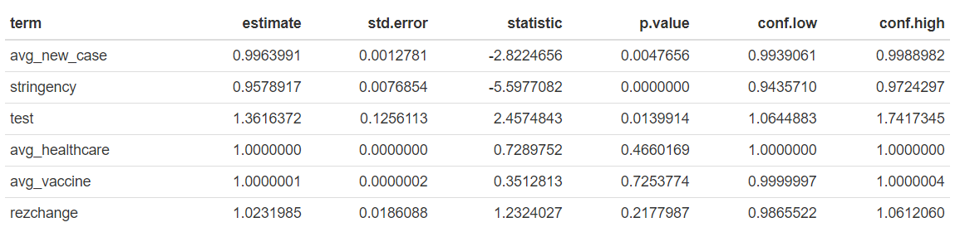
Cox Proportional Hazards Model
1 + new case = 0.5% decrease in likelihood of schools reopening
1 + stringency = 4% decrease in likelihood of schools reopening
1 + testing availability = 36% increase in likelihood of schools opening
Notes:
more stringent, reduces hazard by a factor of 0.96, or by 4%
Being more stringent is associated with ... less likelihood of open schools
More average new cases, reduces hazard by a factor of 0.996, or by 0.5%.;; Increase in new cases is associated with... Less likelihood of open schools
Readily available testing policy increases hazard by a factor of 1.36, or by 36%

Slide 17
Findings
Schools won’t open for a long time!
Readily available COVID-19 testing policy does help schools open!
Spending on vaccine and healthcare is not as effective as strict social distancing!

Slide 18
Final Thoughts

Slide 19
Looking Forward
Find more granular data for U.S. state-level or city-level school reopenings
Especially mobility at school district or city levels
Continue to monitor the daily status of school openness
Include area income, population size, number of schools per district, or school quality into future analysis
Further investigate and explore two-way causality
Apply findings to Columbia’s reopening plans - invest in testing!
Data Source : https://console.cloud.google.com/marketplace/product/bigquery-public-datasets/covid19-public-data-program?project=cdss-hackathon-test&folder=&organizationId=

Slide 20
Thank You!

